Slide 2
“Learn Russian in the European Union”
Sergey Simonov
Director
“Learn Russian in the European Union”
Daugavpils, Latvia
simonov@learnrussianineu.com
tel. +371 65407209, +371 29544413
www.learnrussianineu.com
www.facebook.com/LearnRussianInEU

Slide 4
Why “Learn Russian in the European Union”?
Russian study abroad programs since 2004.
Russian language, Literature, History, Political Science, STEM, and etc.
European ECTS academic credits awarded and transferred to your home university.
Latvia is the safest country in the European Union in regards to COVID-19.

Slide 6
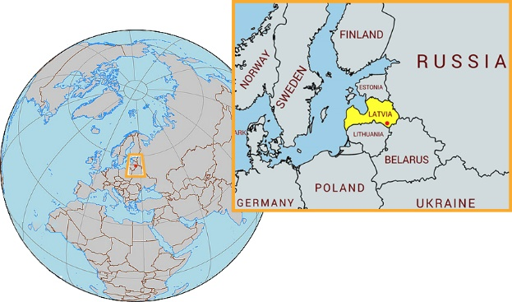
Why Daugavpils?

Slide 7
Why Daugavpils?
Unique Russian language enclave, the most Russian-speaking city in the European Union and NATO
Russian is the primary language of everyday communication.
No visa is required to study in Latvia.
Safe and convenient for study. Ethnic and cultural diversity.
It was part of the Russian Empire and the Soviet Union.
Rich and dramatic military history of 19th-20th centuries
Daugavpils is the perfect place for Russian study abroad.

Slide 9
1100+ students from the USA since 2013 Our major customers:
Defense Language Institute Foreign Language Center (DLI FLC), Monterey, CA;
US Military Academy West Point;
US Naval Academy;
US Air Force Academy;
ROTC Project GO summer immersions;
Undergraduate and graduate students from Columbia, Yale, Emory, Virginia Tech, South Carolina, Washington State, Berkeley, Arizona, Georgia, Alabama, Austin, Denver, Houston, Chicago, Puerto Rico and other universities.

Slide 11
Undergraduate Semester/Academic Year Programs
Customized study abroad programs at Daugavpils University
Up to 15 US credits per semester
Russian language course
Elective courses depending on the program
Russian Literature and Culture, East European Studies, Political Science, History, Physics, Biology, Mathematics, Environmental Sciences, and etc.

Slide 12
Undergraduate Semester/Academic Year Programs
Russian at levels up to Superior
Very small groups or one-on-one
Russian host families
Excursions and study trips
Daugavpils saw Napoleon invasion, Polish uprisings, WW1, the war for independence, WW2, the Holocaust, and fall of the Soviet Union.

Slide 14
Semester/Academic Year Study Abroad Program
Russian Language, Literature and Culture
Russian Language and Political Science
Russian Language and East European Studies
Russian Language and Natural Sciences (STEM)
Learn full details at www.learnrussianineu.com/semester-abroad-programs

Slide 16
ROTC Project GO Summer Immersion Program
Intensive Russian in small subgroups;
Individual grammar consultations;
Native Russian communication partners;
Area studies and relations with Russia;
Excursions and study trips;
Russian host families.

Slide 18
Customized individual programs
Undergraduate and graduate students
One-on-one with professors
Build your dream program
Any time
Learn full details at www.learnrussianineu.com/study/individually-tailored-russian-language-program

Slide 20
Decide and enroll
Learn more at www.learnrussianineu.com,
Direct your inquiries to info@learnrussianineu.com,
Talk to your Study Abroad Adviser,
Apply!

